Slide 1

Receive Events from Event Hub on Azure
Abdul Rasheed Feroz Khan
Director – Code$izzler
Twitter - @TechFero | @CodeSizzler
www.codesizzler.com
#CodeSizzler | #EventHub

Slide 2

Abdul Rasheed Feroz Khan
Founder & Director – CodeSizzler
Microsoft MVP – Azure
7+ years of experience in Training
Azure – IoT – Machine Learning – Cognitive Services – Bot – Xamarin – Big Data
#CodeSizzler | #EventHub
#csharpconf2017, @TechFero
#csharpconf2017, @TechFero Machine Learning with Azure

Slide 3
Receive Events from Azure Event Hub

Slide 4
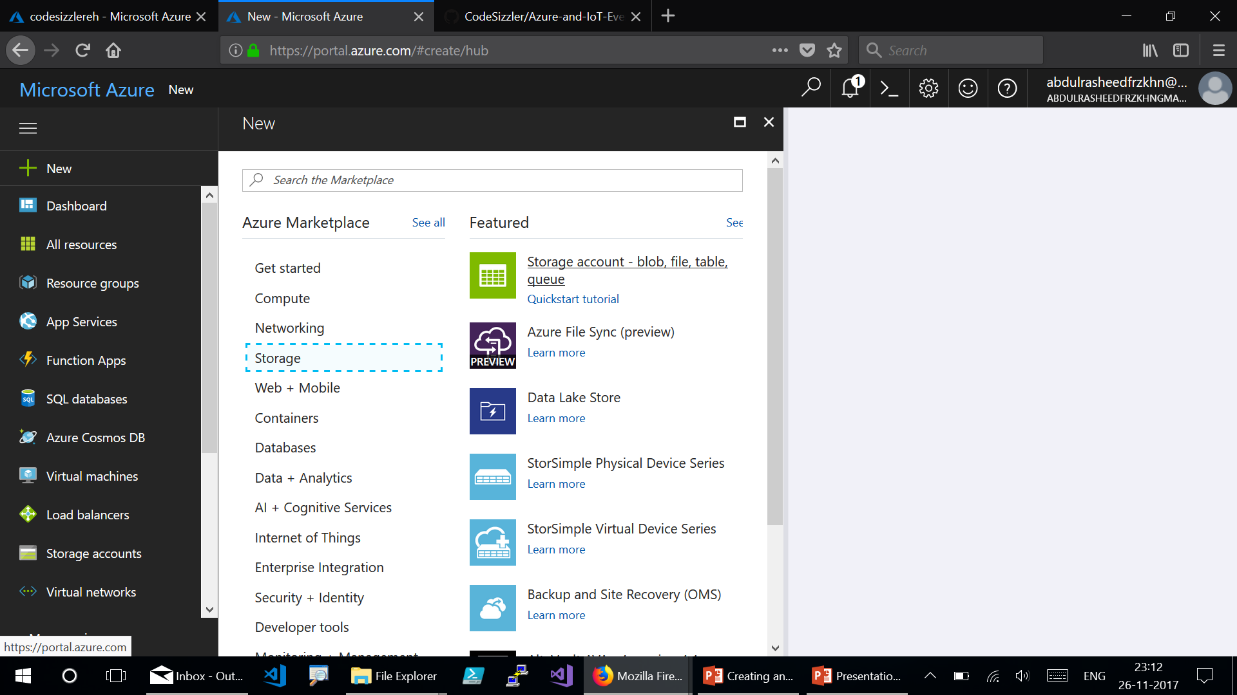
Notes:
Click on New → Storage → Storage Account – Blob, File, Table and Queue.

Slide 5
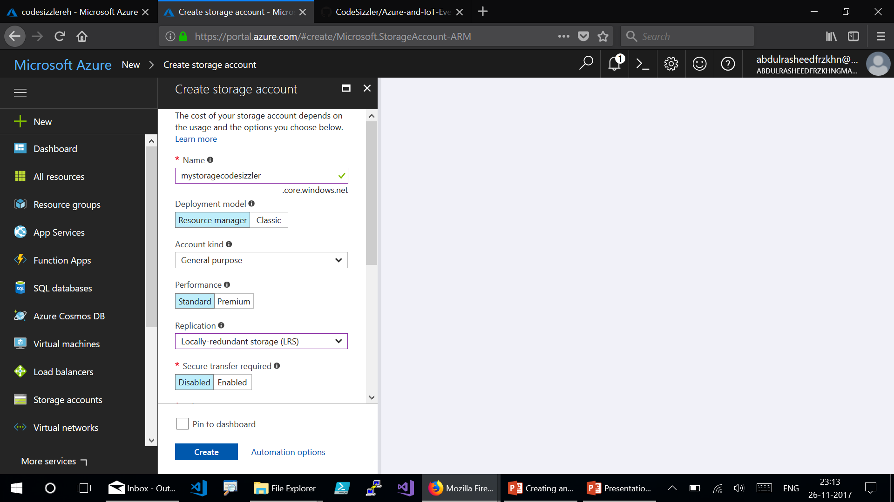
Notes:
Create a Storage Account:
Name
Deployment Model – RM
Account kind – General purpose
Performance – Standard
Replication – Locally Redundant Storage (LRS)
Secure transfer required – Disabled
Click on “Create”.

Slide 6
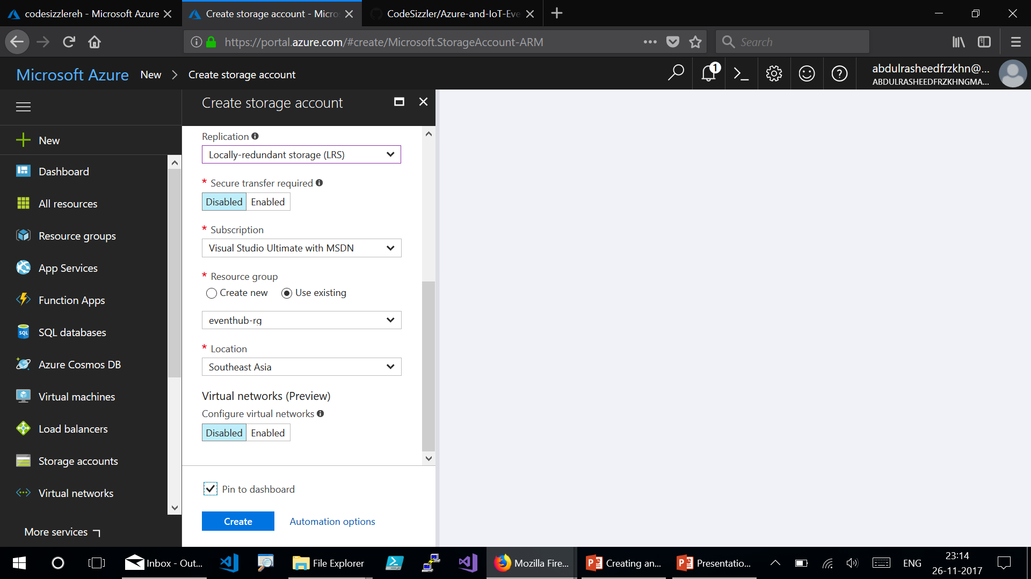

Slide 7
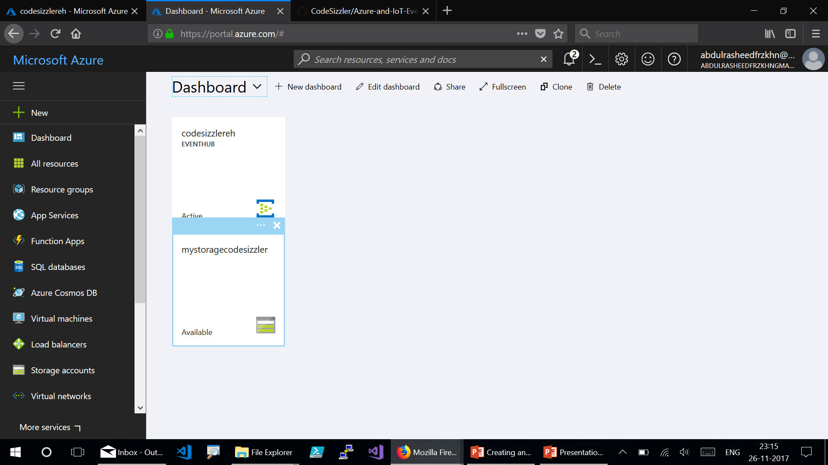
Notes:
Here goes the Storage account deployed.

Slide 8
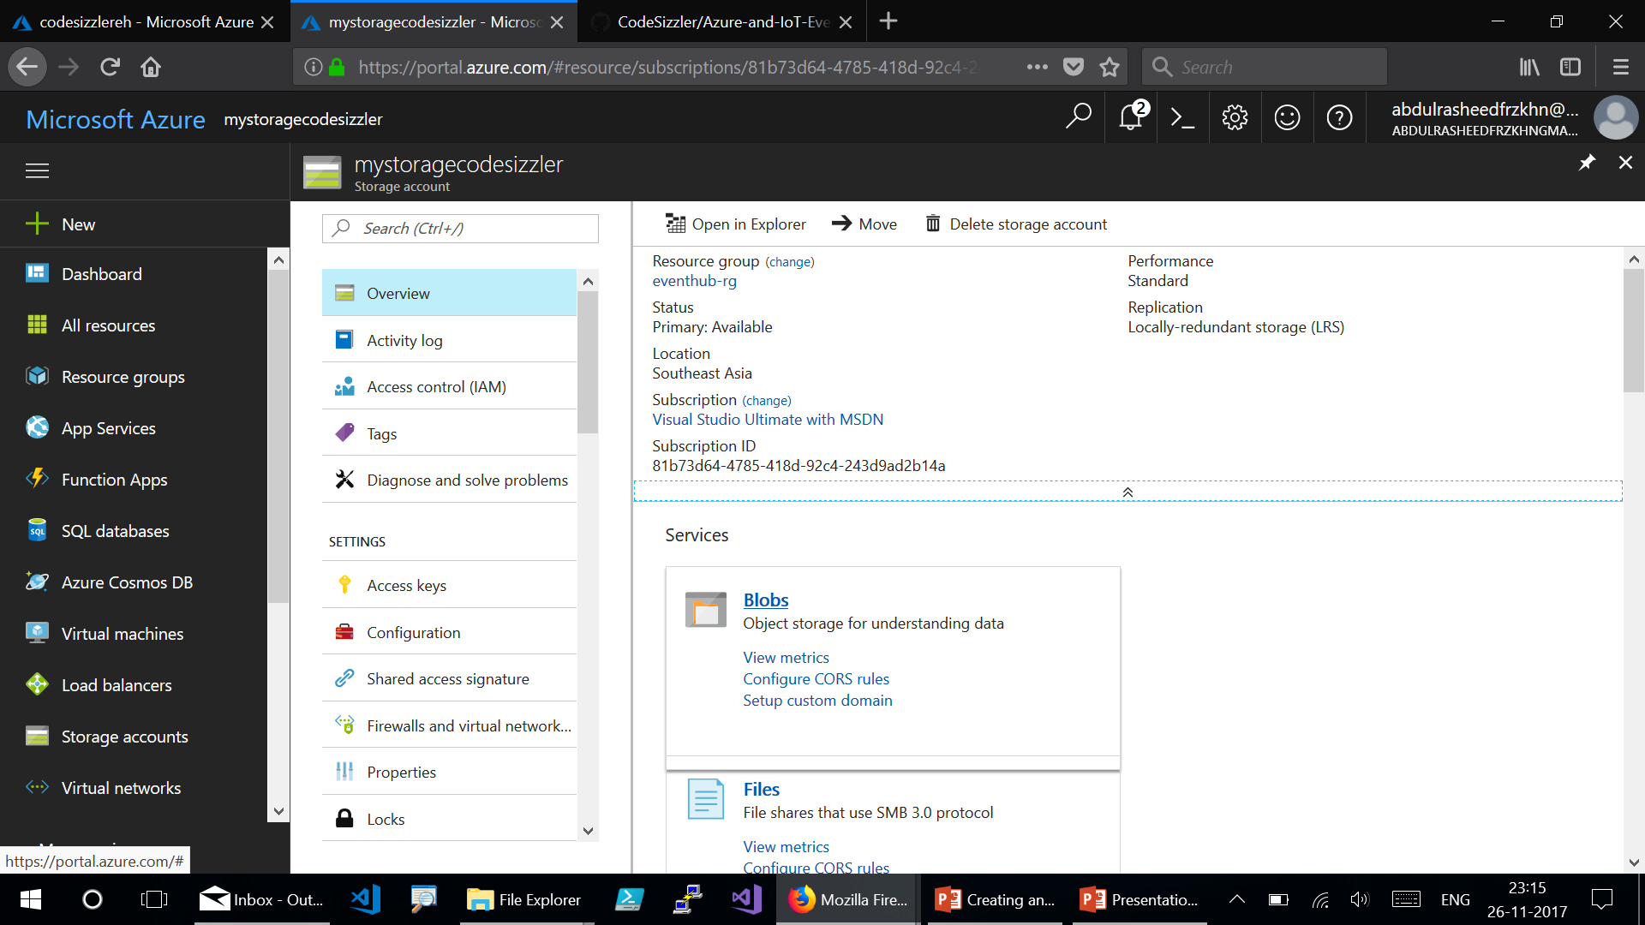
Notes:
Click on “Blobs” to create a blob.

Slide 9
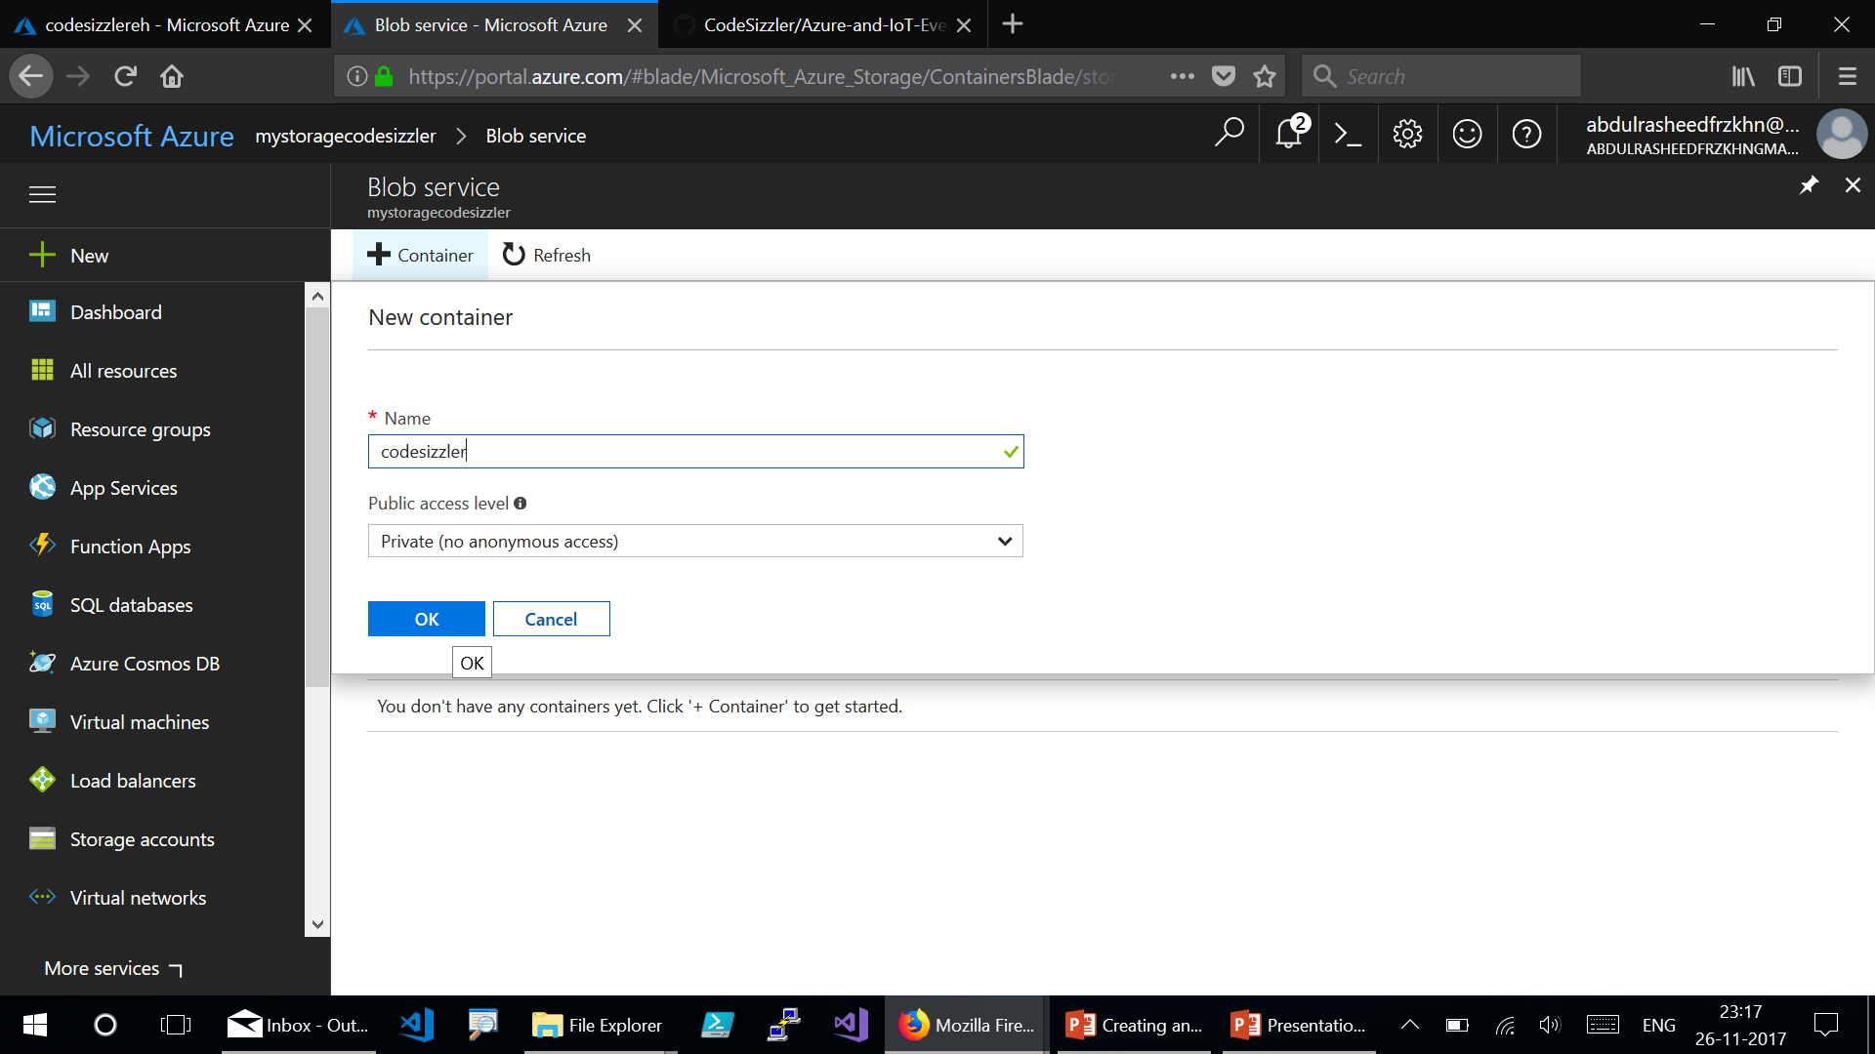
Notes:
Click on “+ Container” to create a New Container. Click on “OK”.

Slide 10
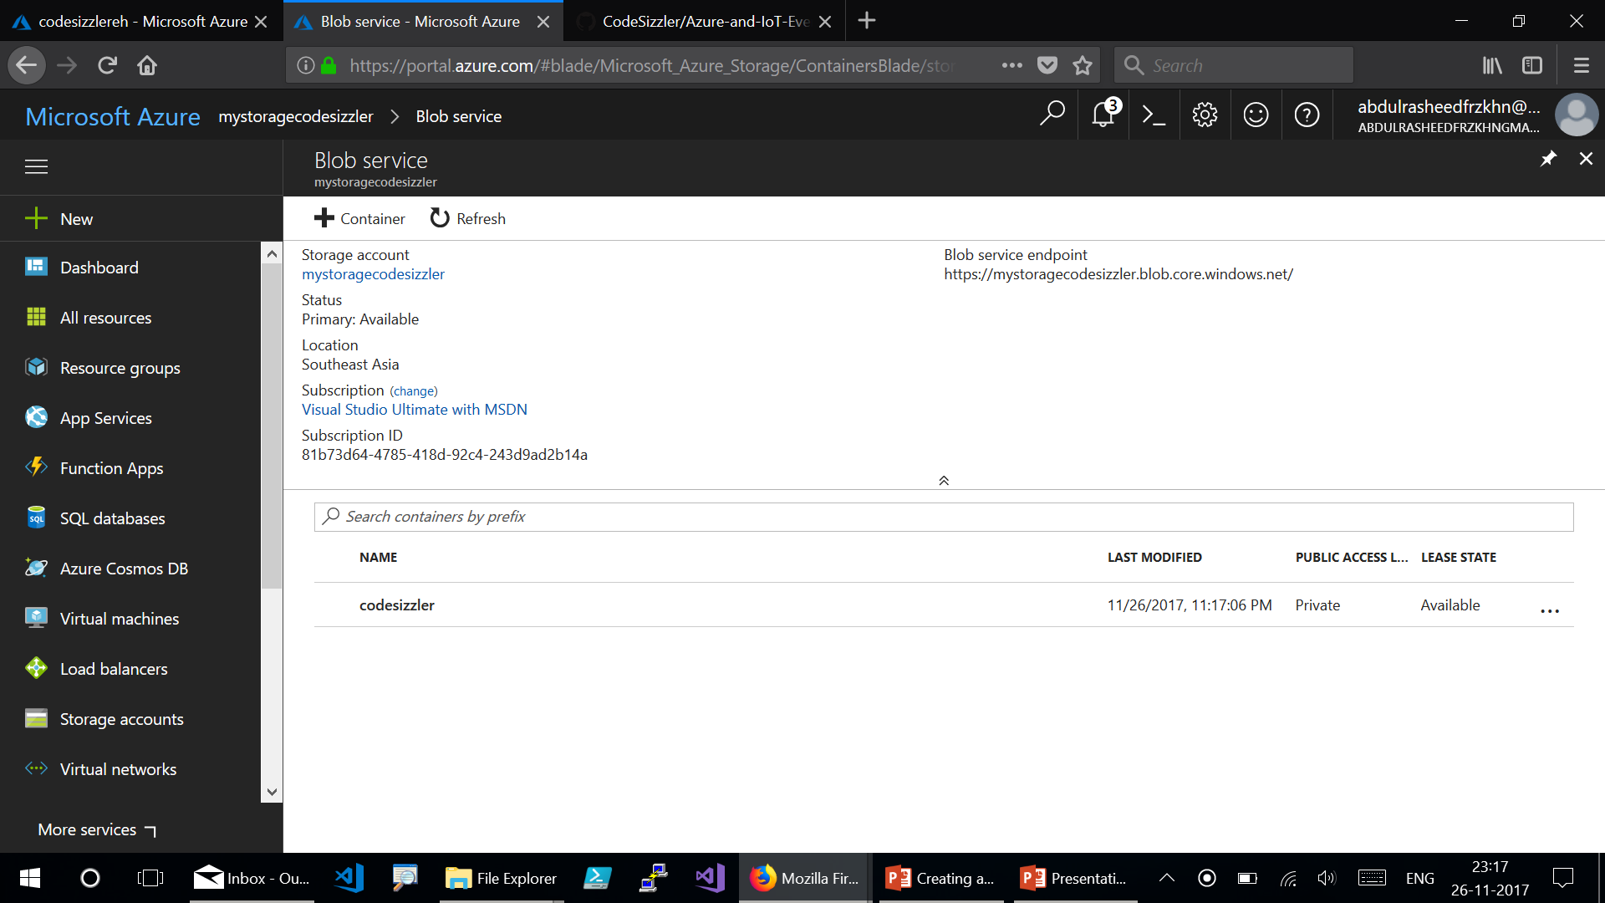
Notes:
Here goes the blob service with container deployed.

Slide 11
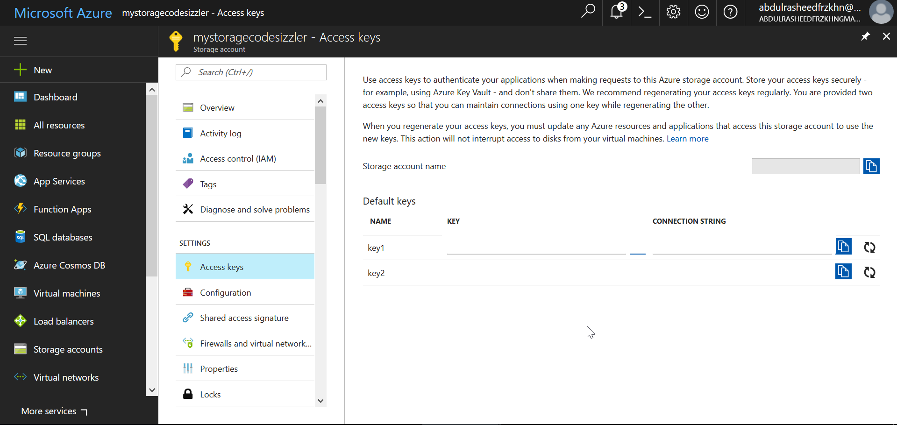
Notes:
Go for the Access Key, copy the storage account name and key1 – paste it on a notepad.

Slide 12
Receive events from .NET console app

Slide 13
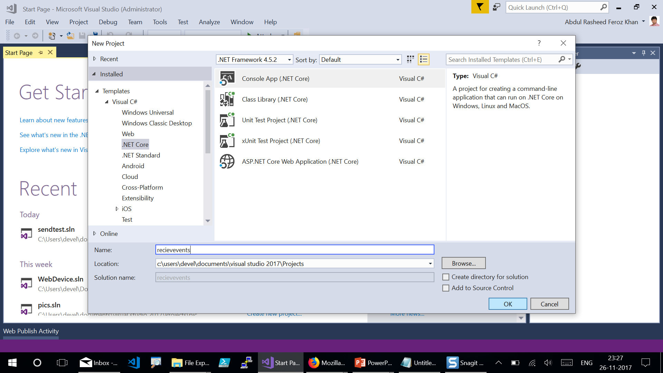
Notes:
Start Visual Studio. From the File menu, click New, and then click Project. Create a .NET Core console application.

Slide 14
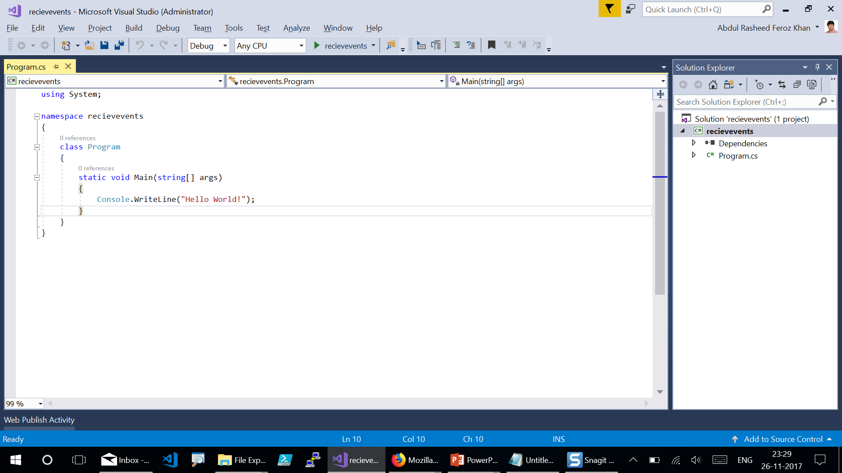
Notes:
This is the home page of where the console app gets loaded up.

Slide 15
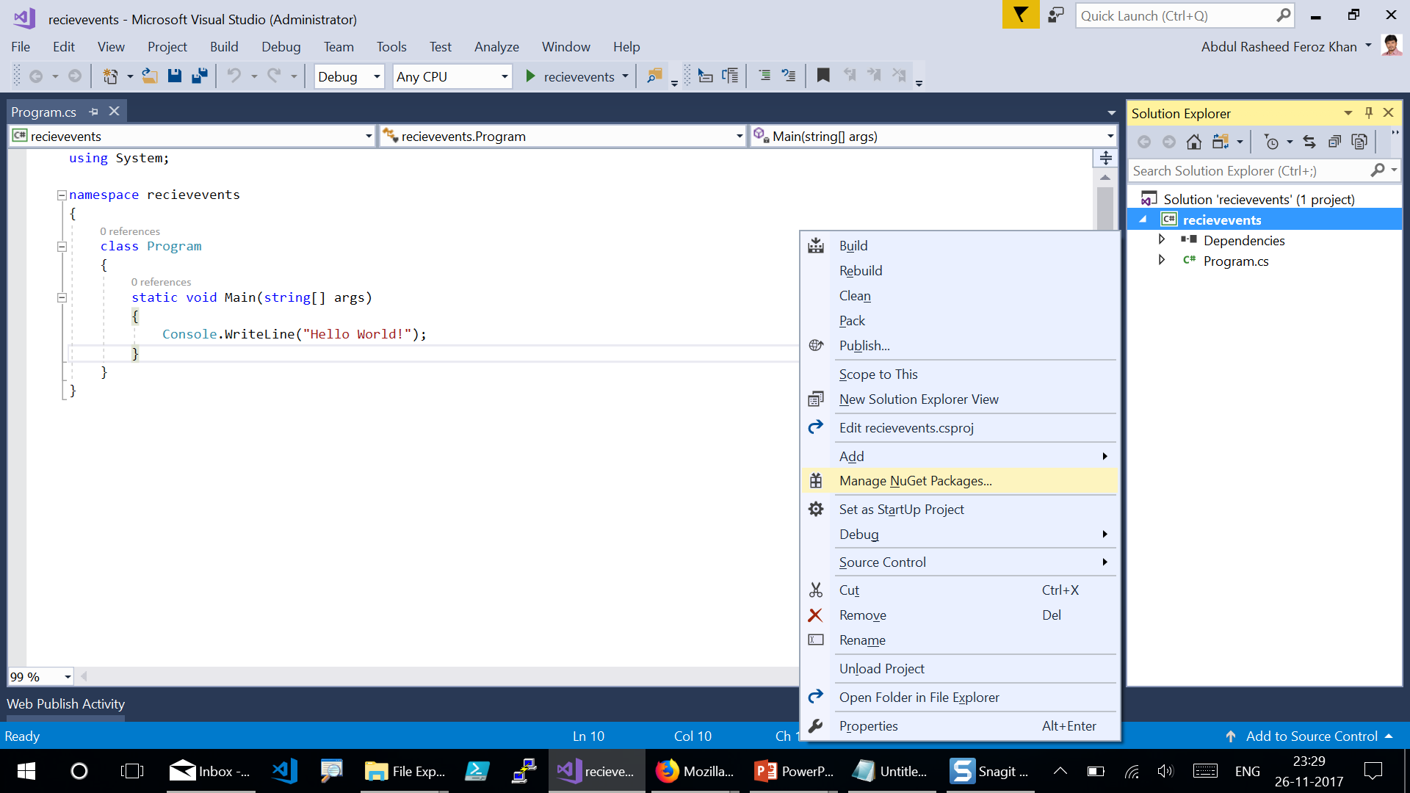
Notes:
Right-click the newly created project and select Manage NuGet Packages

Slide 16
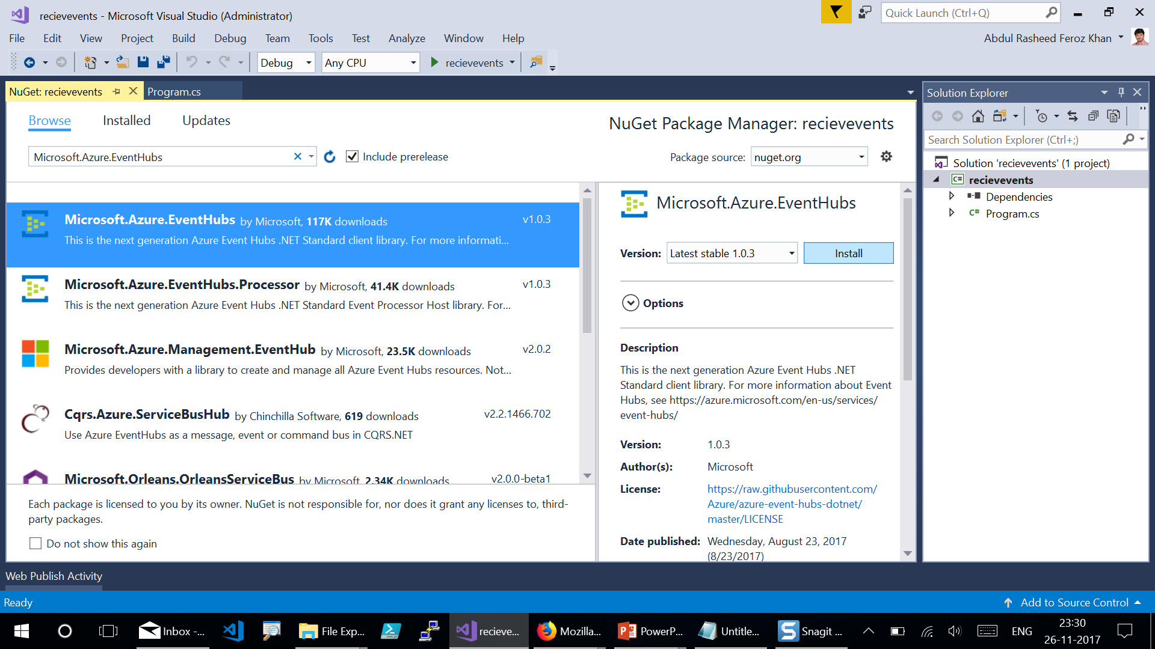
Notes:
Click the Browse tab, then search for "Microsoft.Azure.EventHubs" and select the Microsoft.Azure.EventHubs package. Click Install to complete the installation, then close this dialog box.

Slide 17
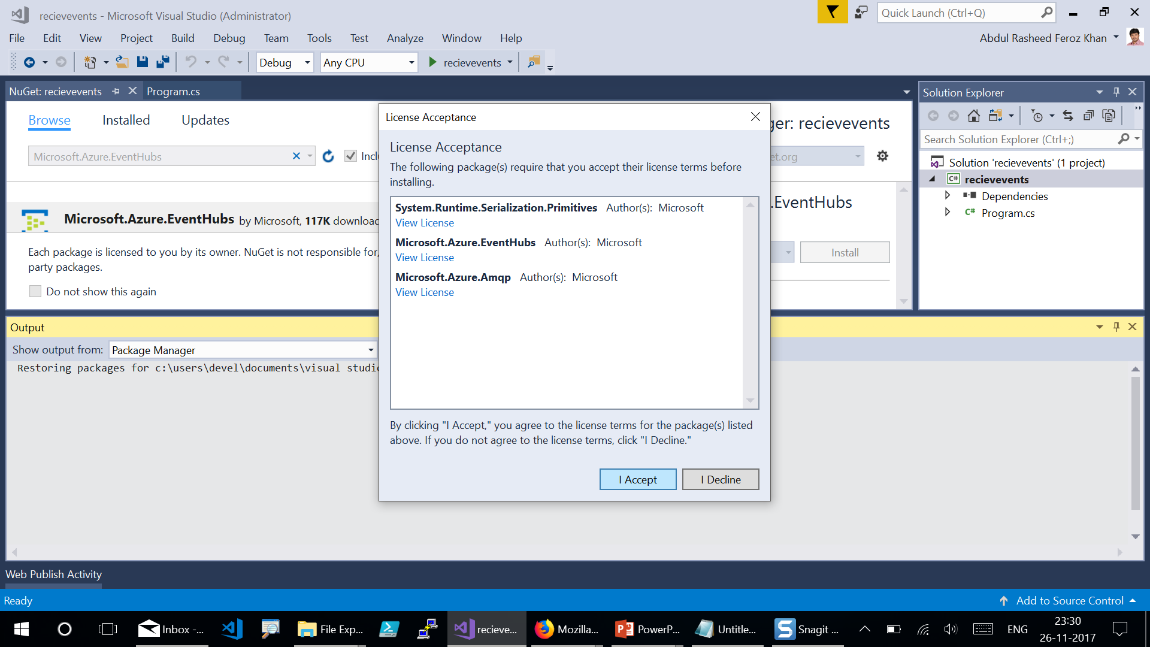
Notes:
Click on “I Accept” to install Microsoft.Azure.EventHubs

Slide 18
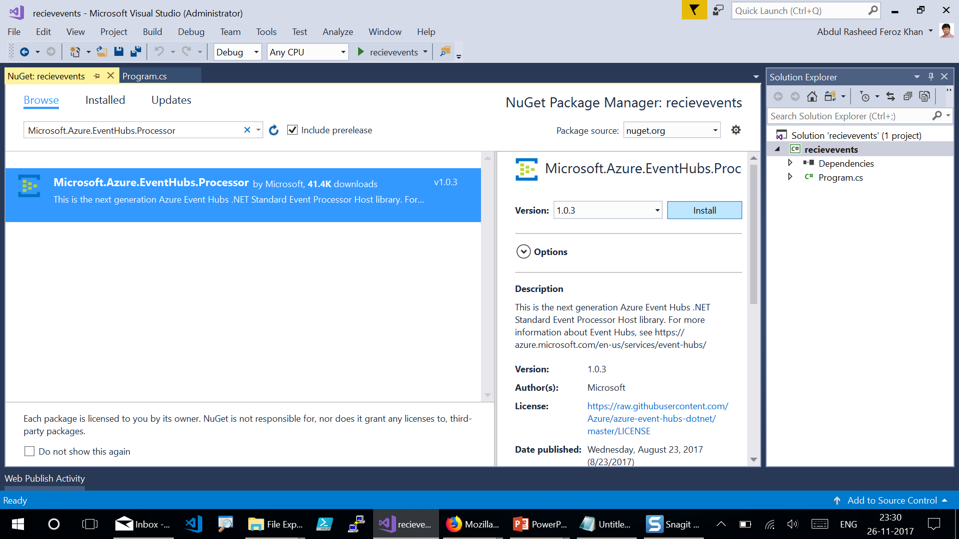
Notes:
Click the Browse tab, then search for "Microsoft.Azure.EventHubs.Processor" and select the Microsoft.Azure.EventHubs.Processor package. Click Install to complete the installation, then close this dialog box.

Slide 19
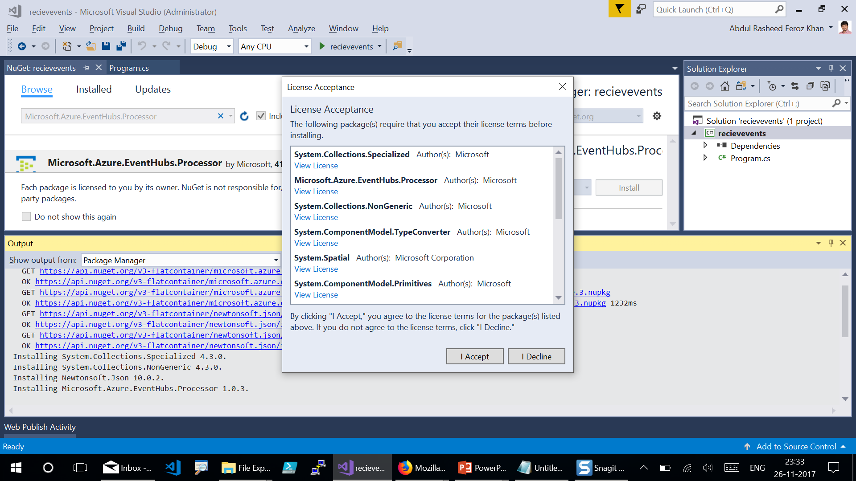
Notes:
Click on “I Accept”.

Slide 20
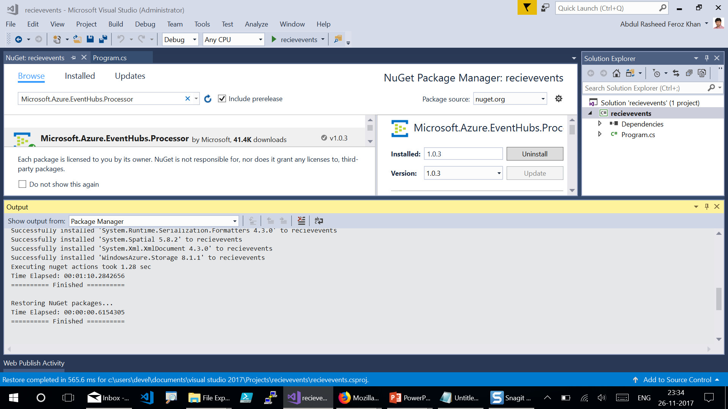

Slide 21
Implement the IEventProcessor interface

Slide 22
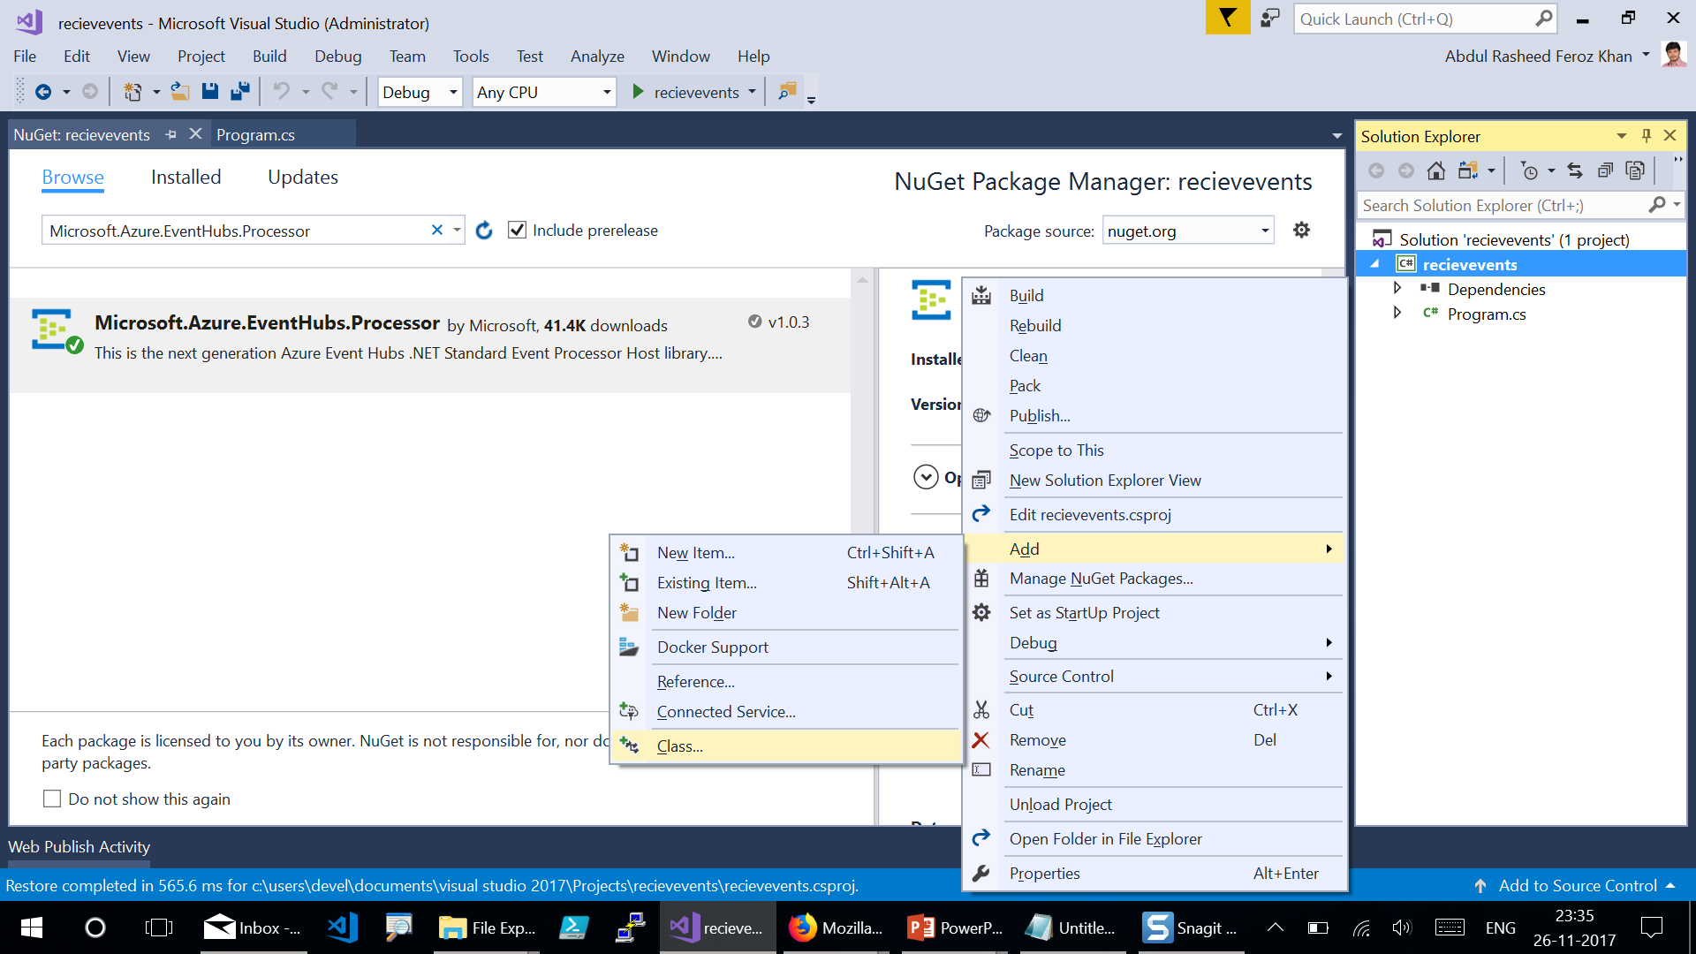
Notes:
In Solution Explorer, right-click the project, click Add, and then click Class. Name the new class SimpleEventProcessor.

Slide 23
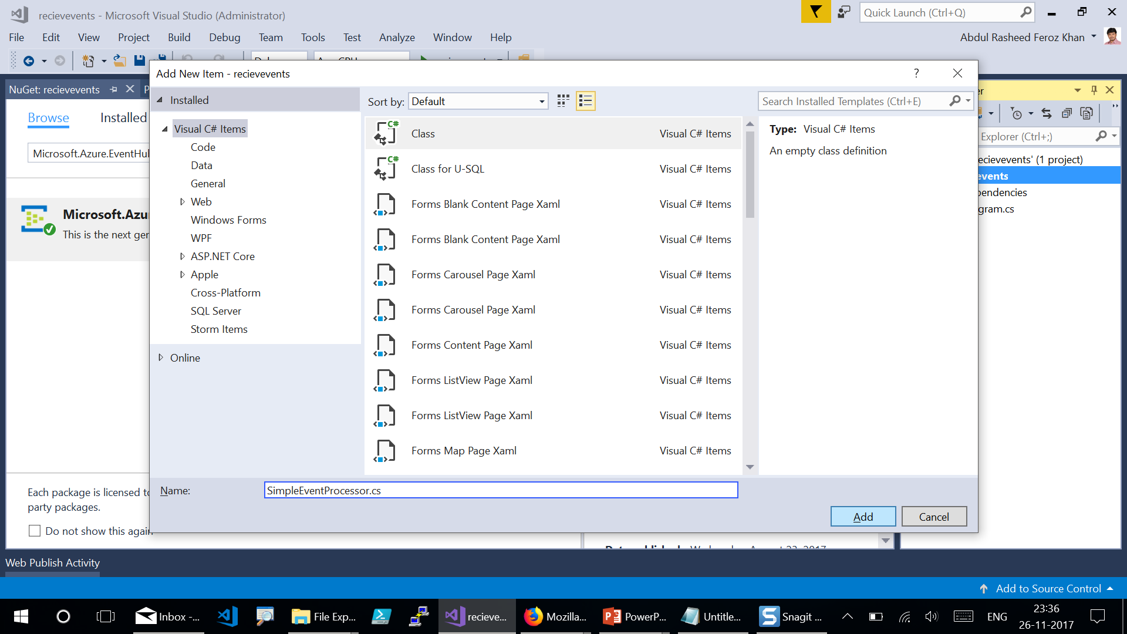

Slide 24
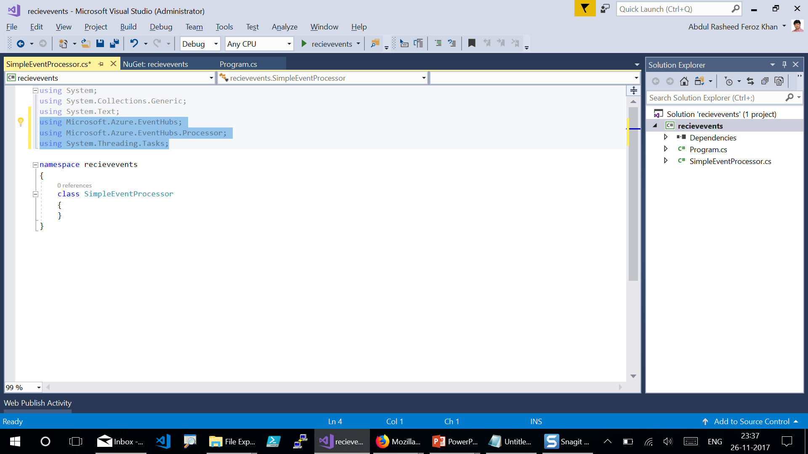
Notes:
Open the SimpleEventProcessor.cs file and add the following using statements to the top of the file.
Code link: https://codeshare.io/aYyjRb
Code Snippet:
using Microsoft.Azure.EventHubs;
using Microsoft.Azure.EventHubs.Processor;
using System.Threading.Tasks;

Slide 25
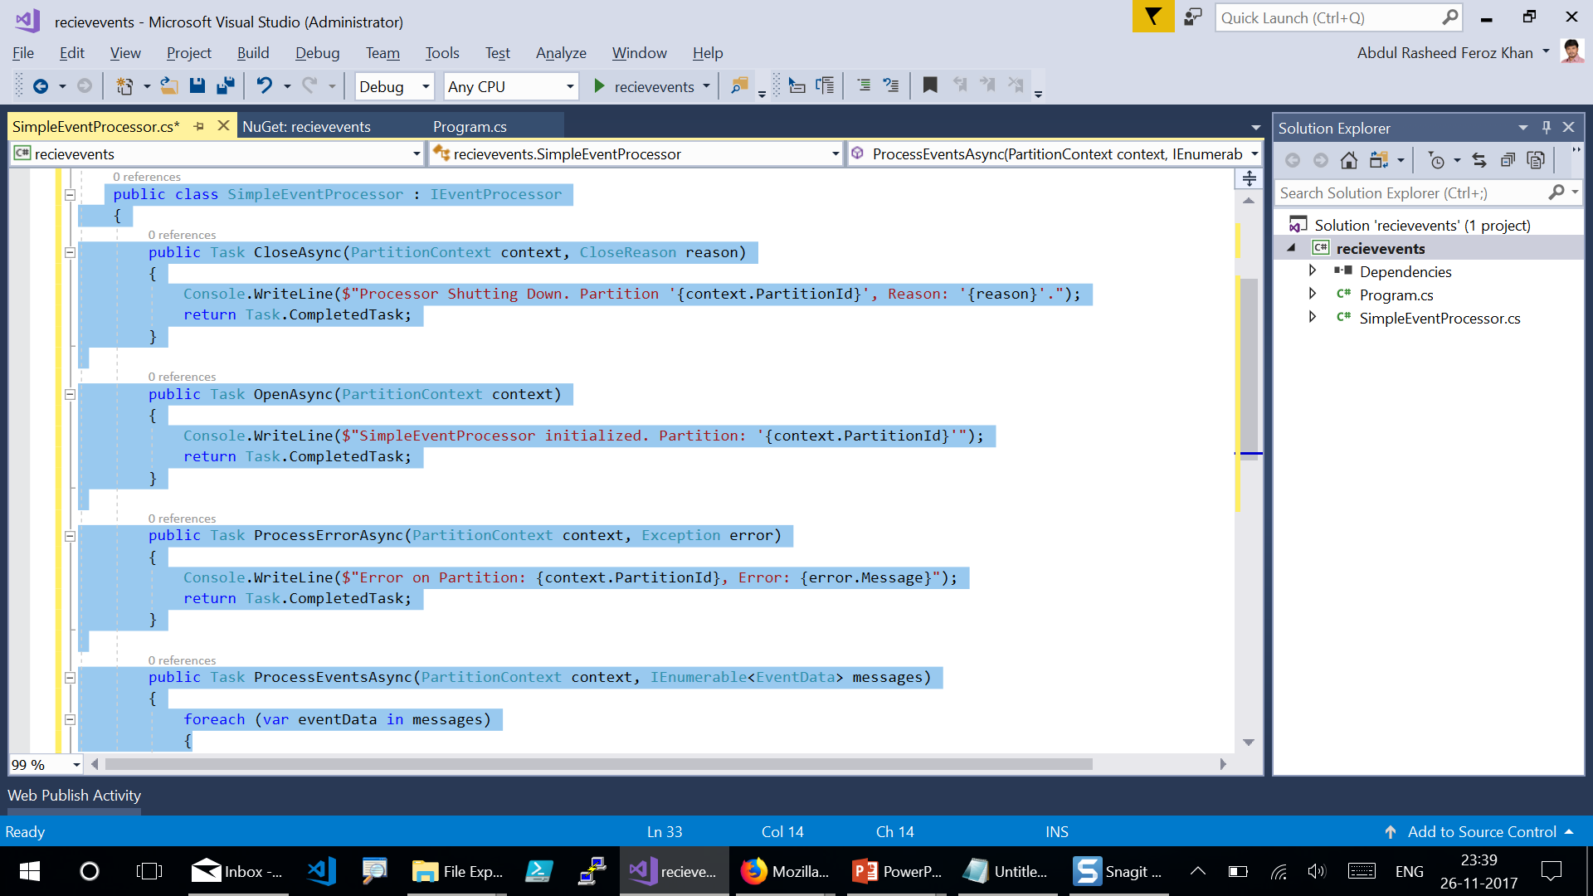
Notes:
Code Link - https://codeshare.io/5QgoNL

Slide 26
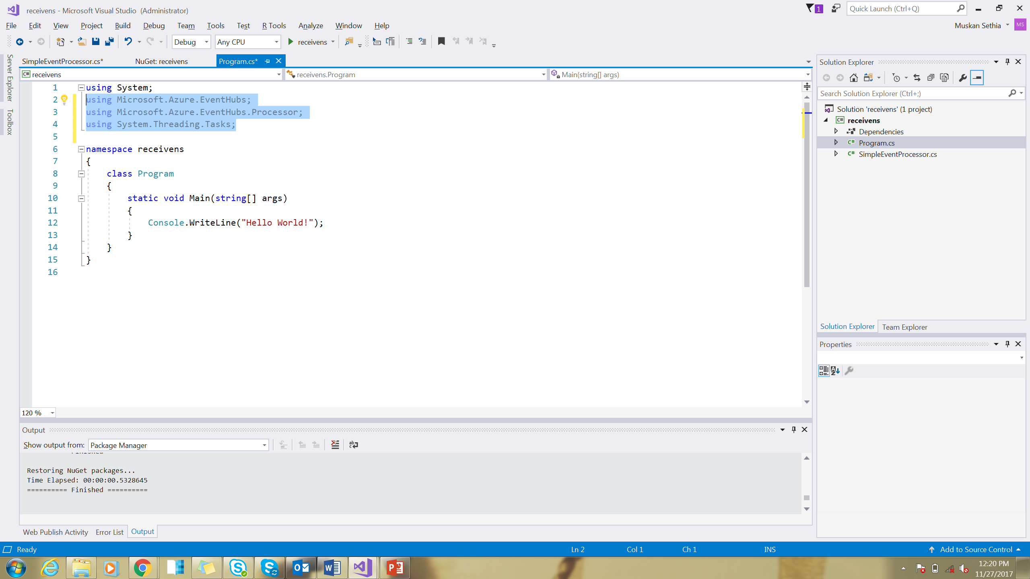
Notes:
Go for Program.cs and add the using statements of below:
using Microsoft.Azure.EventHubs;
using Microsoft.Azure.EventHubs.Processor;
using System.Threading.Tasks;

Slide 27
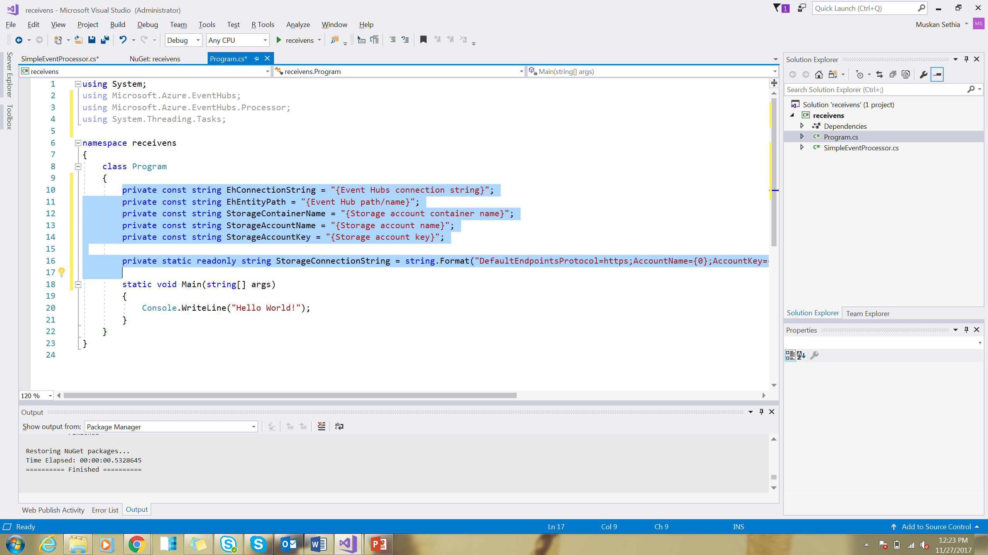
Notes:
Add constants to the Program class for the event hub connection string, event hub name, storage account container name, storage account name, and storage account key. Add the following code, replacing the placeholders with their corresponding values.
Code link - https://codeshare.io/G6xv1z

Slide 28
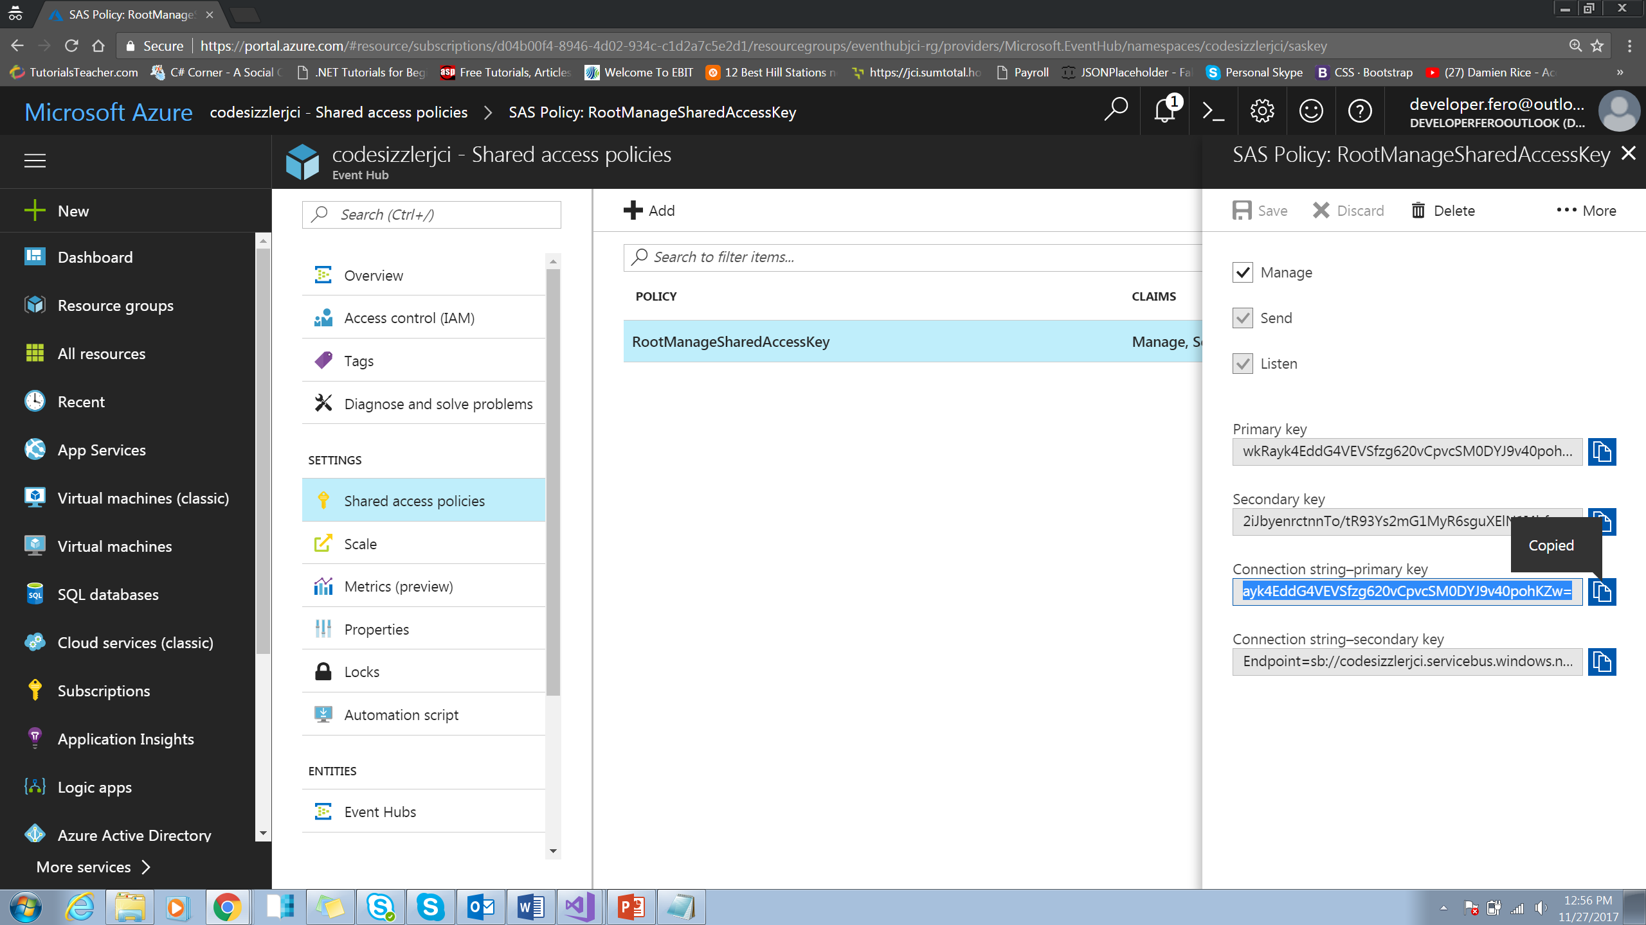
Notes:
Copy the required connection keys from azure portal to replace it on the code snippet

Slide 29
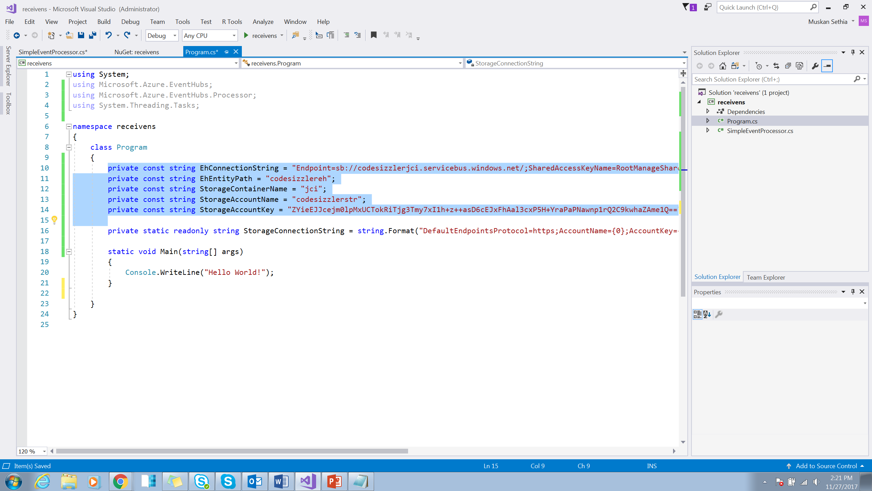
Notes:
Add constants to the Program class for the event hub connection string, event hub name, storage account container name, storage account name, and storage account key. Add the following code, replacing the placeholders with their corresponding values.
Code Snippet - https://codeshare.io/G8q4QE

Slide 30
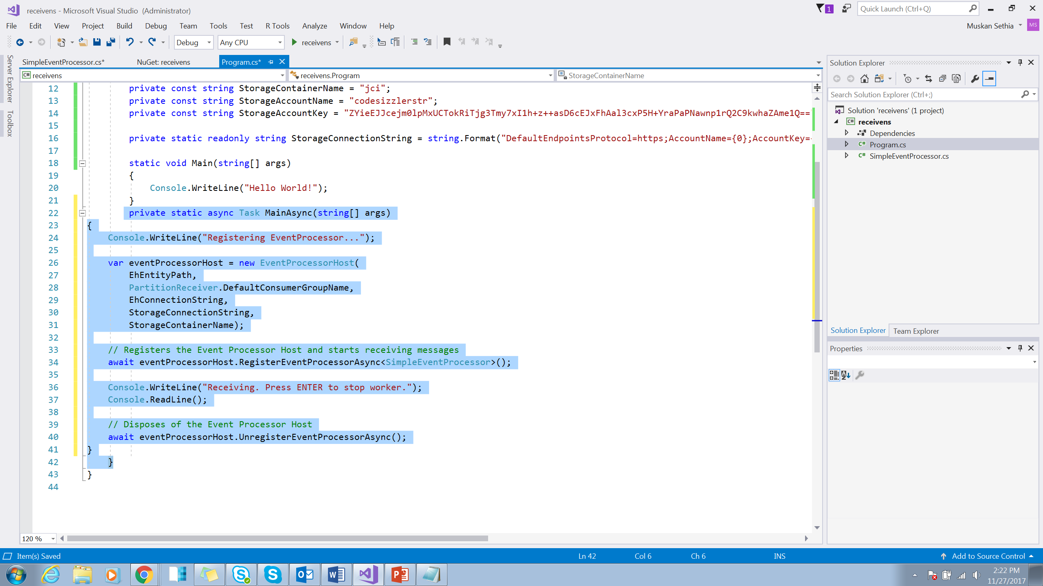
Notes:
Add a new method named MainAsync to the Program class, as follows:
Code Snippet - https://codeshare.io/anqe01

Slide 31
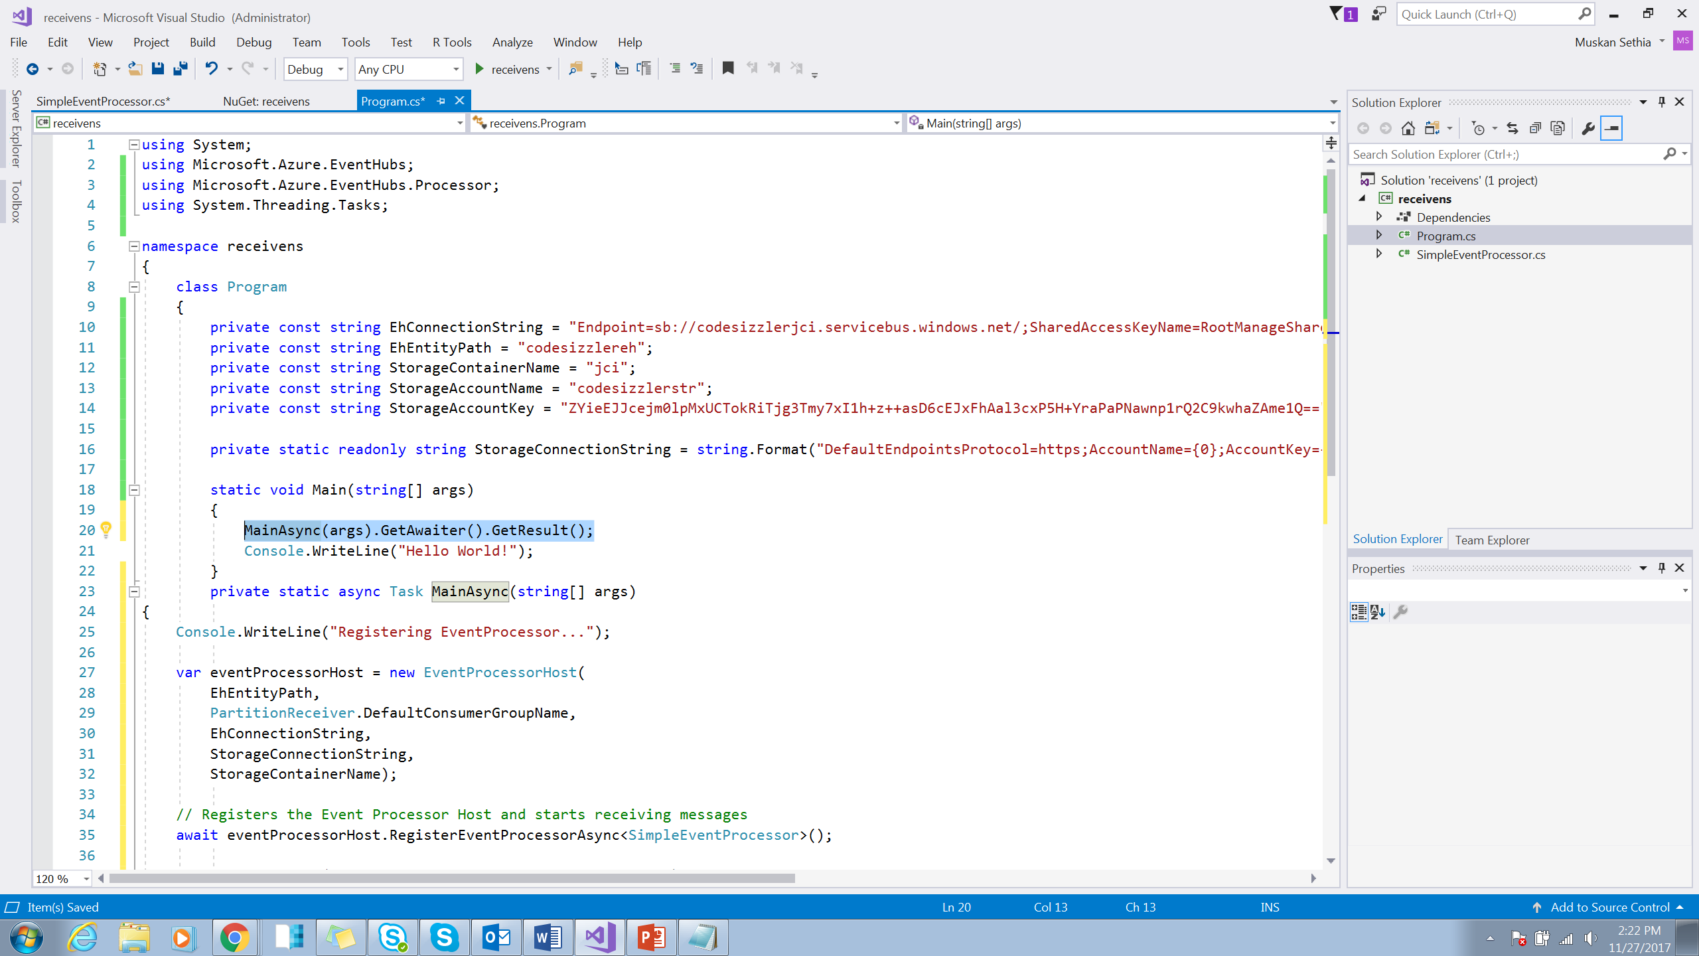
Notes:
Add the following line of code to the Main method:
Code Snippet - https://codeshare.io/5oLKAr

Slide 32
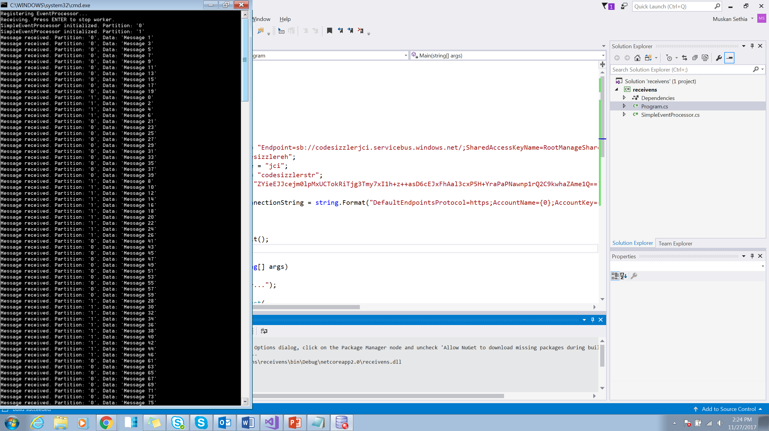
Notes:
Run the program now.

Slide 33
